Slide 1

ENVIRONMENTAL MONITORING
.....

Slide 2
Environmental Monitoring prototype
Components:
NODE ESP32
DHT22
Connecting wires

Slide 3
Sensing
Temperature
Humidity

Slide 4
Working principle
The ESP32 is a microcontroller that works by executing instructions and processing data. It has a dual-core processor, which means it has two separate processing units that can work simultaneously. This allows for better multitasking and improved performance. The ESP32 also has built-in Wi-Fi and Bluetooth capabilities, making it easy to connect to the internet and communicate with other devices. It's commonly used in IoT projects to enable wireless connectivity and control.

Slide 5
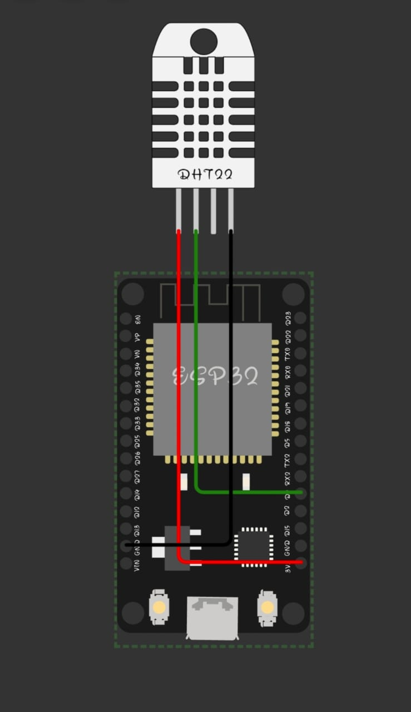
Prototype

Slide 6
Working
To simulate environmental monitoring, you would create a program that collects data from sensors placed in the environment. This data can include temperature, humidity, air quality, and more. The program would periodically read the sensor values and store them for analysis. You can then use this data to monitor and analyze environmental conditions over time,
identify trends, and make informed decisions based on the data collected. It's a great way to gain insights and take proactive measures to maintain a healthy and sustainable environment.
The environmental monitoring system based on wireless sensor network technology is an online monitoring and management support system. Whether the system works normally or not is directly related to the evaluation of monitoring performance and the online diagnosis of equipment working state.

Slide 7
Python script
#include <DHT.h>
#define DHTPIN 4
#define DHTTYPE DHT22
DHT dht(DHTPIN, DHTTYPE);
void setup() {
Serial.begin(115200);
dht.begin();
}
void loop() {
delay(2000);
float temperature = dht.readTemperature();
float humidity = dht.readHumidity();
("40 %"); }}

Slide 8
if (isnan(temperature) || isnan(humidity)) {
Serial.println("Failed to read from DHT sensor!");
} else {
Serial.print("Temperature: ");
Serial.print(temperature);
Serial.println(" 24°C");
Serial.print("Humidity: ");
Serial.print(humidity);
Serial.println(“40 %”) ;
}

Slide 9

....

